Slide 1
Online Course Management and Study Planner for Students

Slide 2
Problem Statement
Facilitate online course registration for students.
Allow advisors to handle requests online.
Allow professors to manage course activities.
Study planner creation for students.

Slide 3
Review
Iteration1
- Domain model
Use cases model
Data model
Sequence diagram
UI Prototype
Iteration 2
Implementation of
- Search Course
- Register Course
- Drop Course
- Swap Course

Slide 4
Iteration 3
Implementation of
Create/Save/Delete Study Plan(Student)
Add/Edit/Delete Course(Administrator)
Add/Edit/Delete OfferedCourse(Adminstrator)
HandleRequests(Advisor)
Changed RegisterCourse use case.
Added checks based on course prerequisites for registration.

Slide 5
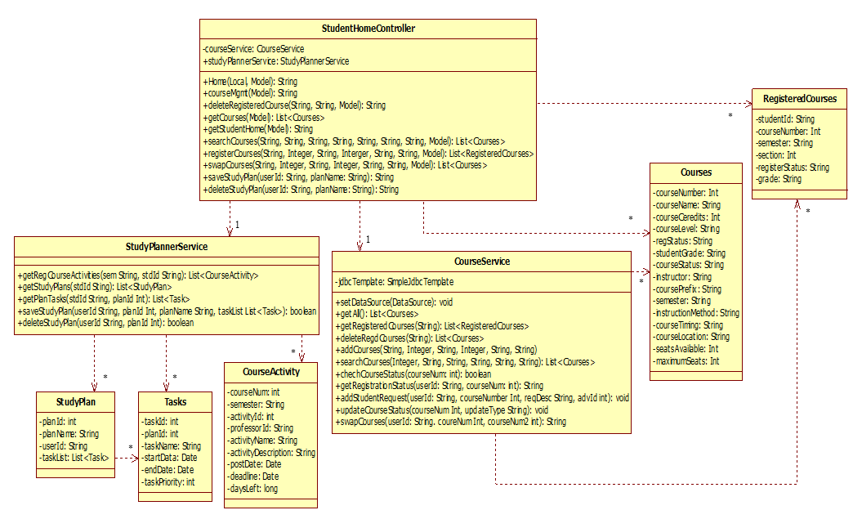
Design Class Diagram
Design Class Diagram

Slide 6
Class Diagram Cont

Slide 7
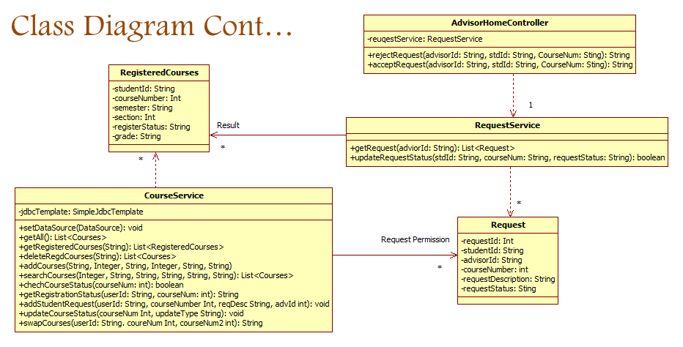
Class Diagram Cont…

Slide 8
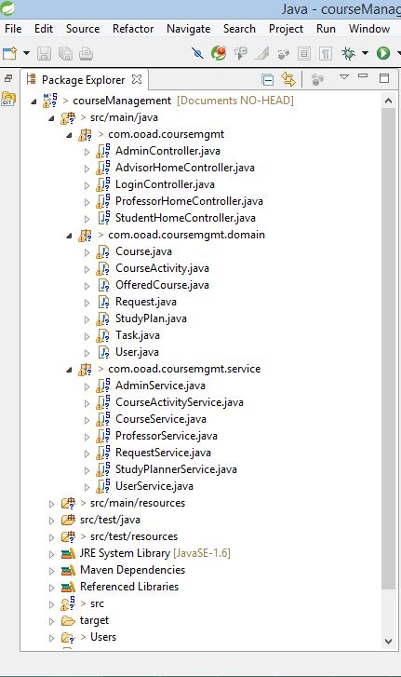
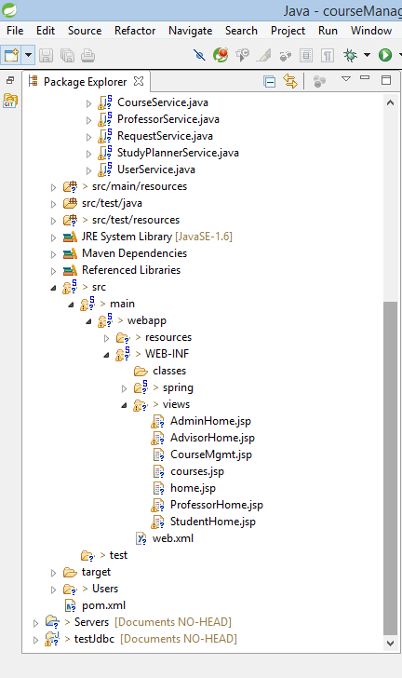

Slide 9
Sequence Diagrams

Slide 10
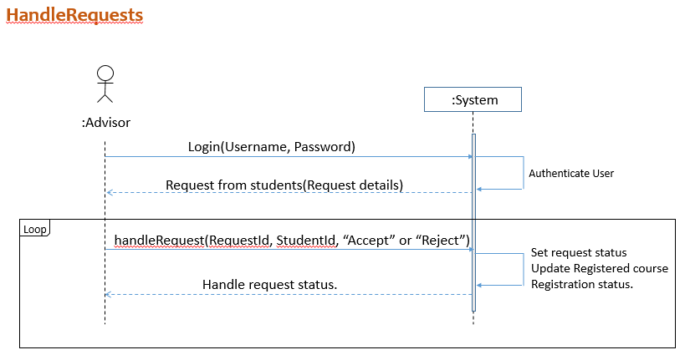
Advisor Related

Slide 11
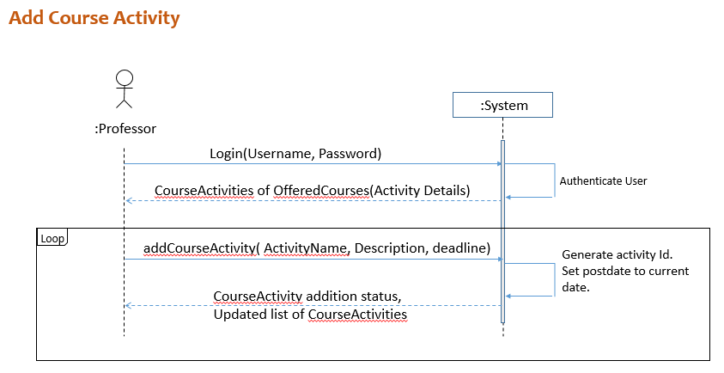
Professor Related

Slide 12
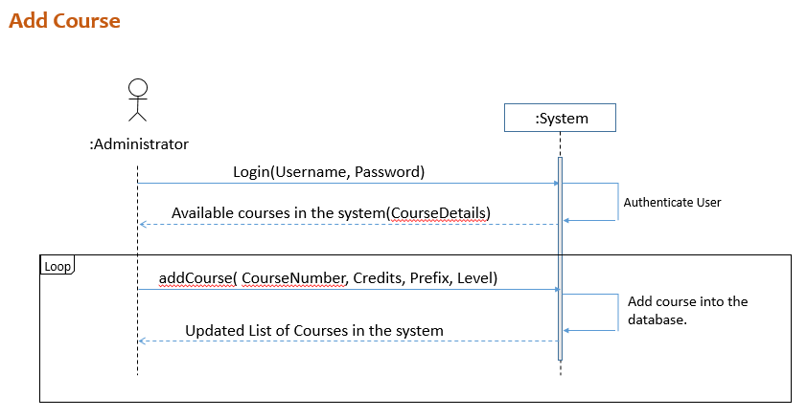
Administrator Related

Slide 13
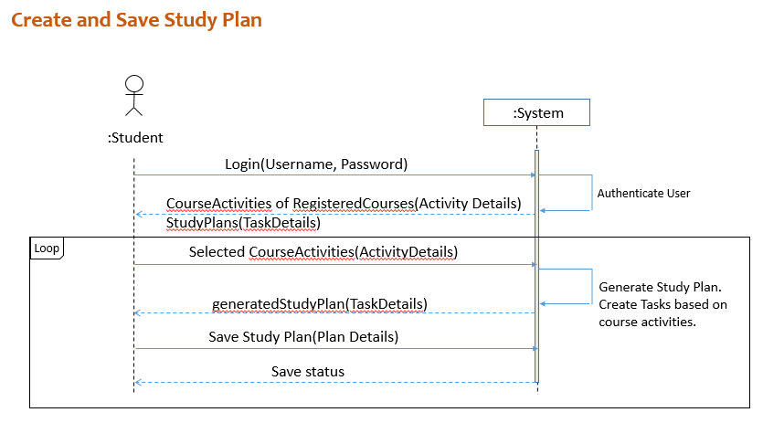
Study Planner

Slide 14
Operation Contract
OC3: createStudyPlan
Operation: createStudyPlan
Cross references: Use case – Student
Pre-condition:
The student must be registered with some courses for the semester.
The registered course should have some course activities associated with them.
Post-condition:
an instance of StudyPlan was created
For every task in the study plan, an instance of task was created.
The created instance of study plan was associated with the user.
The created instances of tasks were also associated with the user.

Slide 15
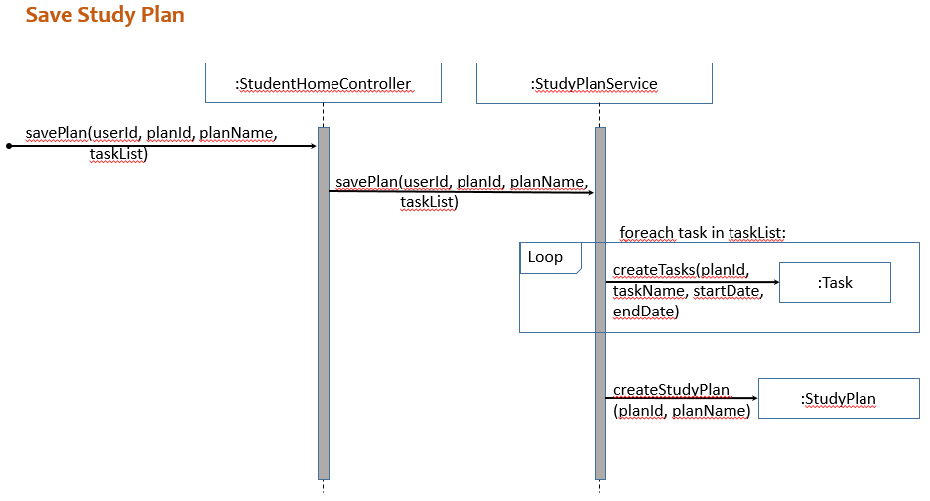
Sequence Diagram - SaveStudyPlan

Slide 16
Patterns Used In the Design Process
Spring MVC Model
Controller
Low Coupling
High Cohesion
Pure Fabrication and Indirection

Slide 17
Enhancements
We can have waitlist for courses
Ability to register for multiple courses at a time
Improve algorithm for study planner creation.

Slide 18
THANK YOU…

